Slide 1

Project
Project author: Sapar Oralbek
Examinator: Zhangir Rayev
Project topic: “Food order”

Slide 2
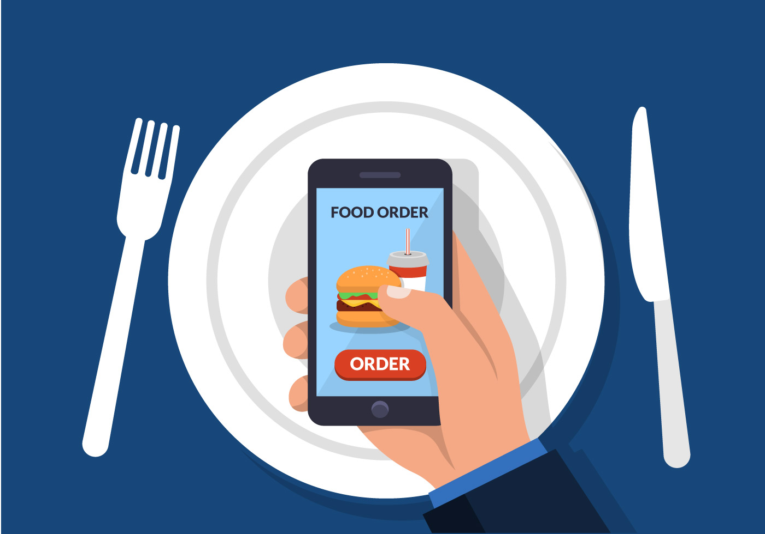
objective:
Accepts food orders and calculates the total amount

Slide 3


Relevance and idea
The restaurant business is the leader in the number of bankruptcies. Not everyone can create a successful restaurant. These are all pitfalls, subtle and characteristic. People come to a restaurant not only for delicious food. They want to relax in a comfortable environment. And comfort is created not only by the interior, atmosphere, but also by service. Therefore, it is important to provide quality service in the restaurant. Finding qualified employees is not as easy as it might seem at first glance.

Slide 4

Relevance
My project will help solve several problems of the restaurant business. When visiting restaurants, we lose a lot of time waiting for the waiter and his service. With the help of my project, you can make an order from the first minute in the restaurant and save more time, since the order will be placed immediately and you will see the total invoice. This is convenient and beneficial not only for guests and the owner of the restaurant as it will solve the problem of theft of personnel and fewer employees will cope with work, this also saves staff salaries.

Slide 5
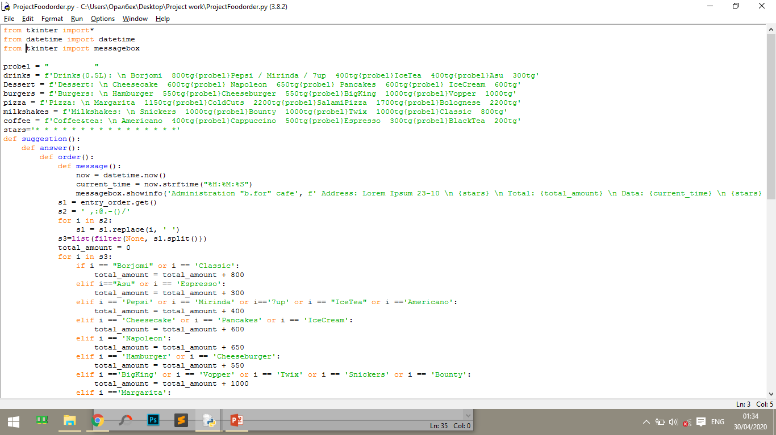
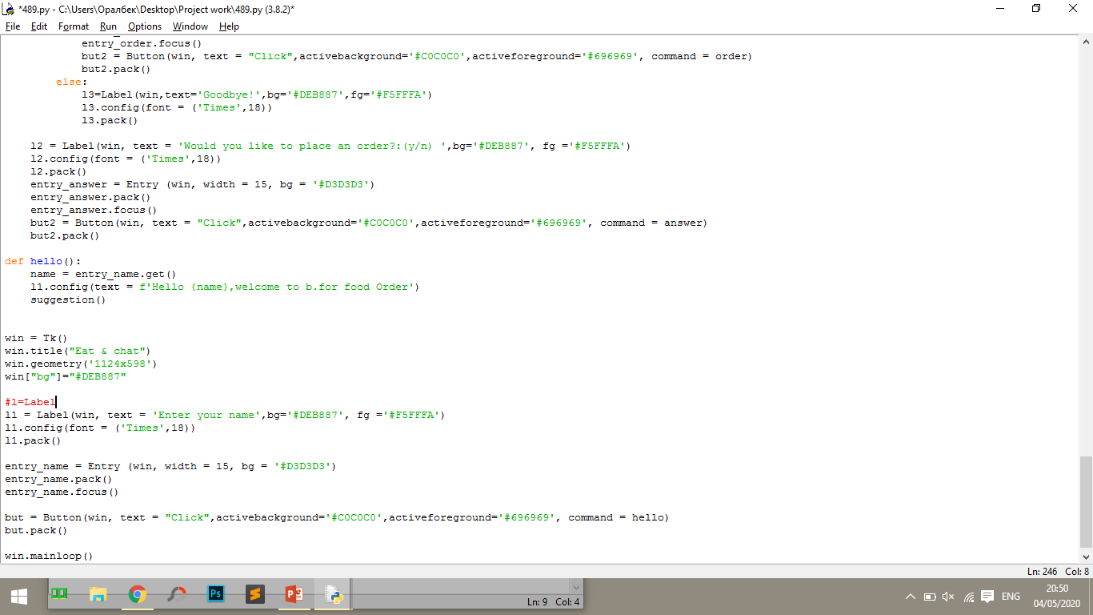
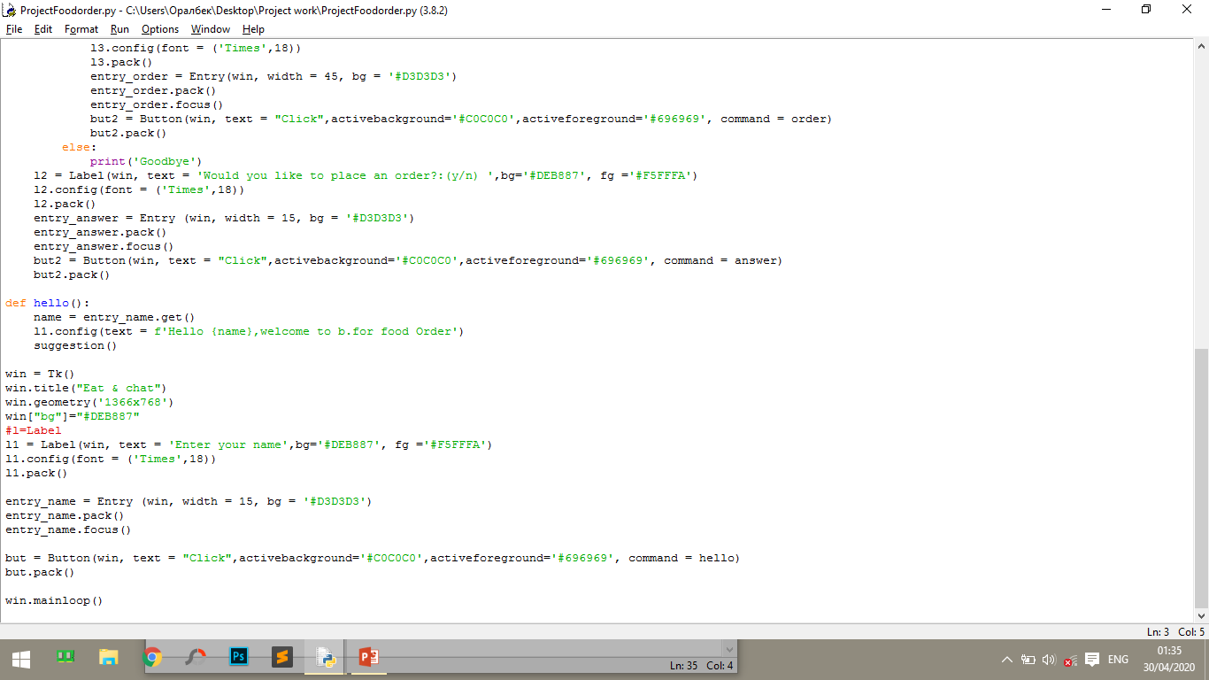
First, import Tkinter and create a window in which we set its name:
The Tkinter library is installed in Python as a standard module, so we do not need to install anything to use it.
To add text, we will create ‘l1’ using the Label class, for example:
ve
we can set the font of the text and size. To do this, pass the “font” parameter like this:
We can create a text field using the Tkinter Entry class as follows:
The last line calls the mainloop function. This function causes an infinite loop of the window, so the window will wait for any user interaction until it is closed.
We start by adding a button to the window. The button is created and added to the window in the same way as the label:

Slide 6
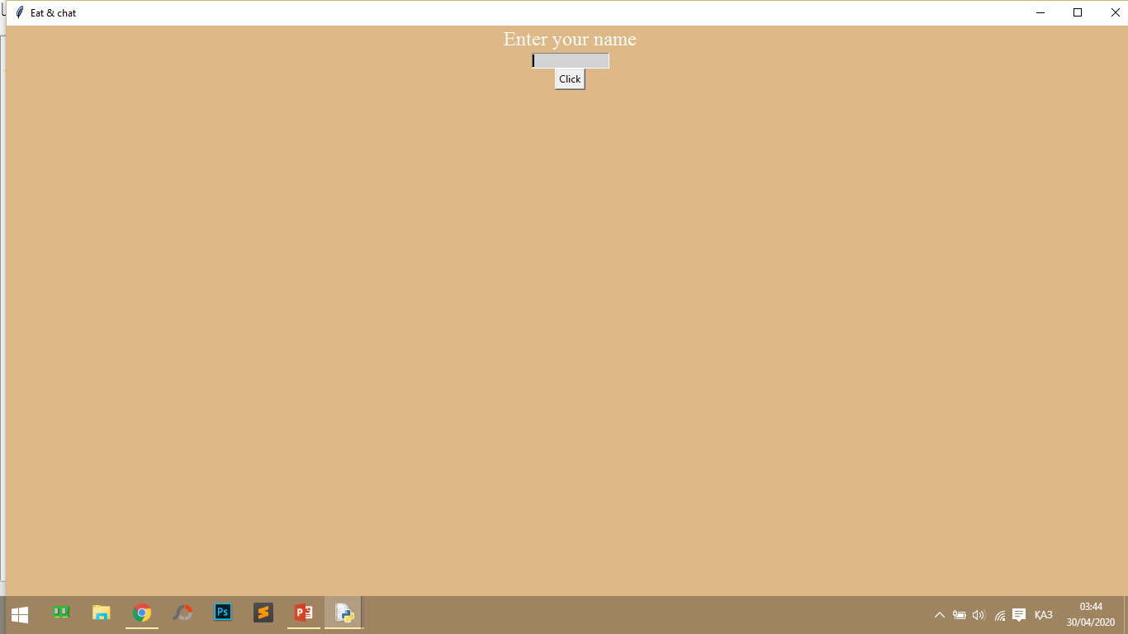
The result will be as follows:

Slide 7
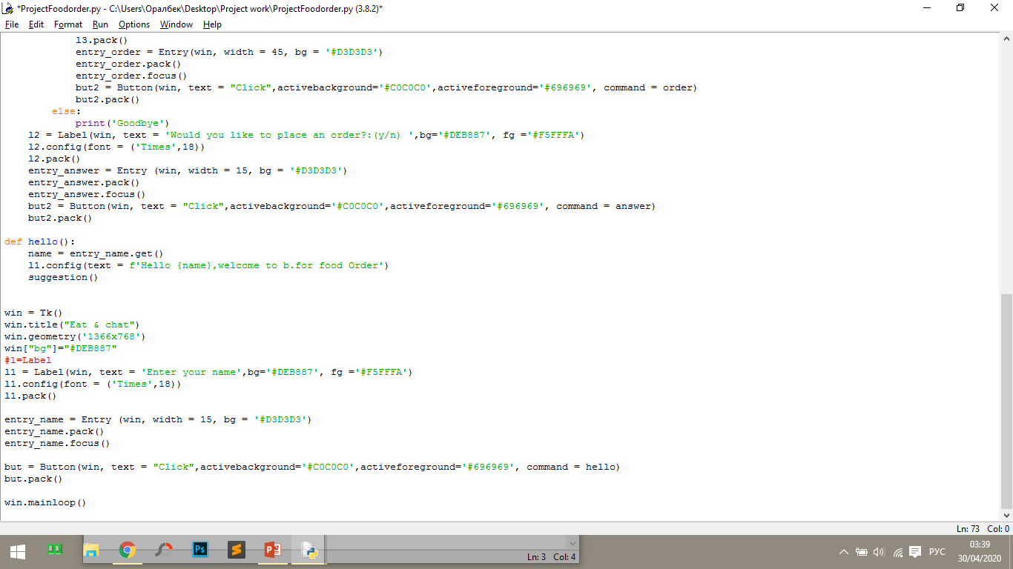
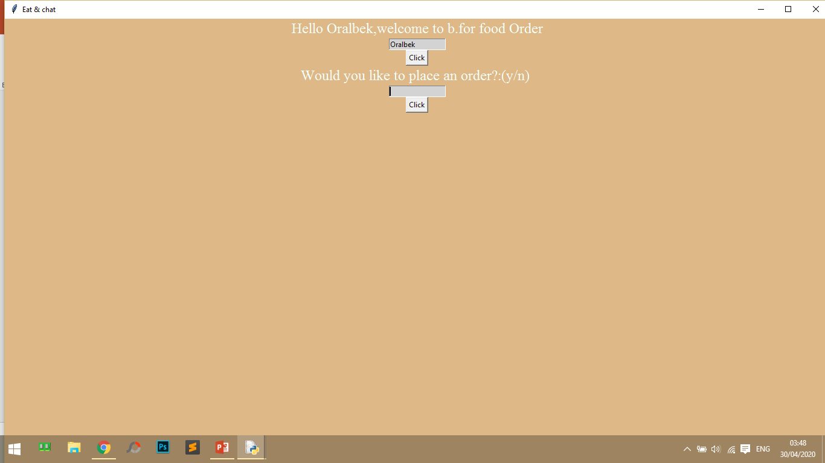
name of the variable to which the value from the input field will be written
get what you typed in “entry_name" and put in “name"
input field name
function to be executed when the button is pressed:
To get the select element, you can use the get function like this:
The result will be as follows:

Slide 8
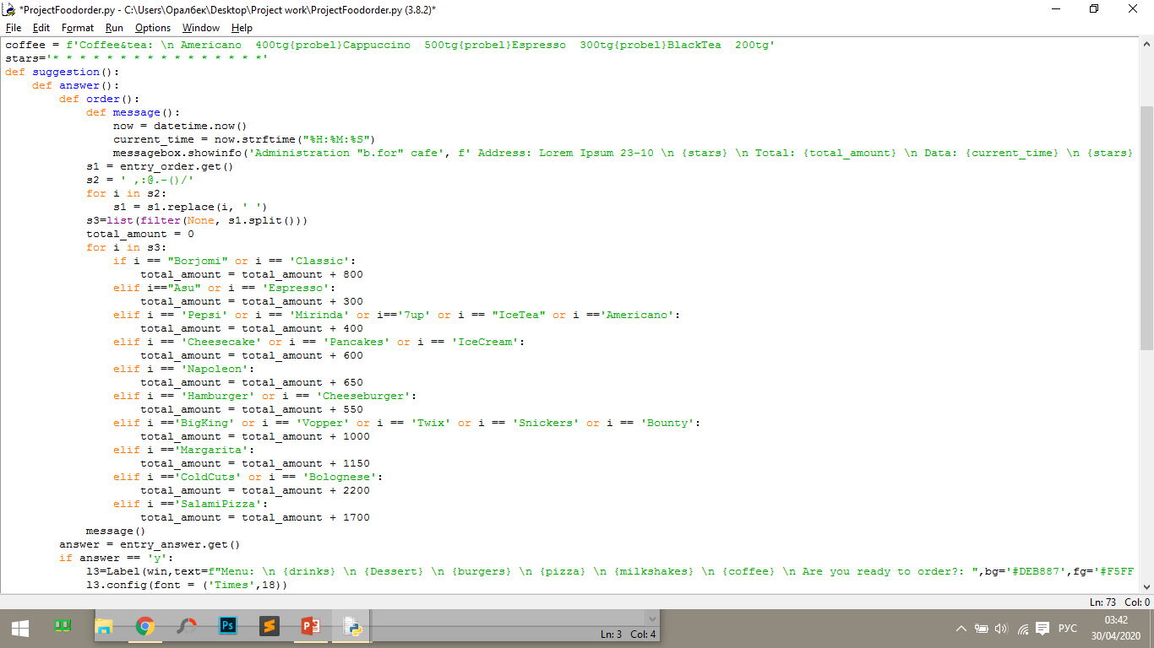
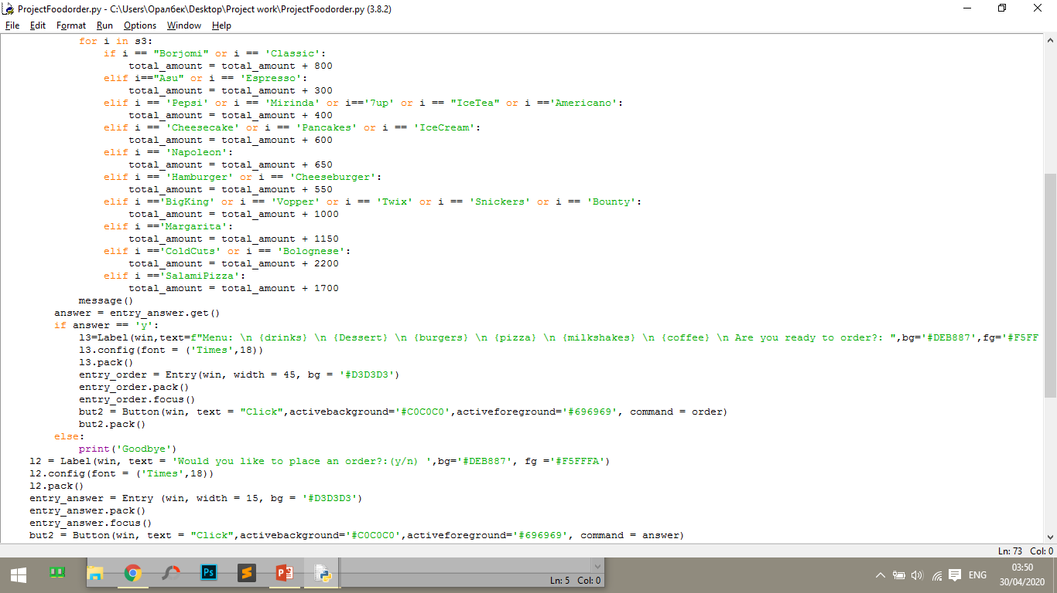
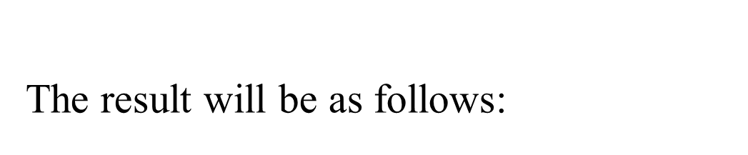

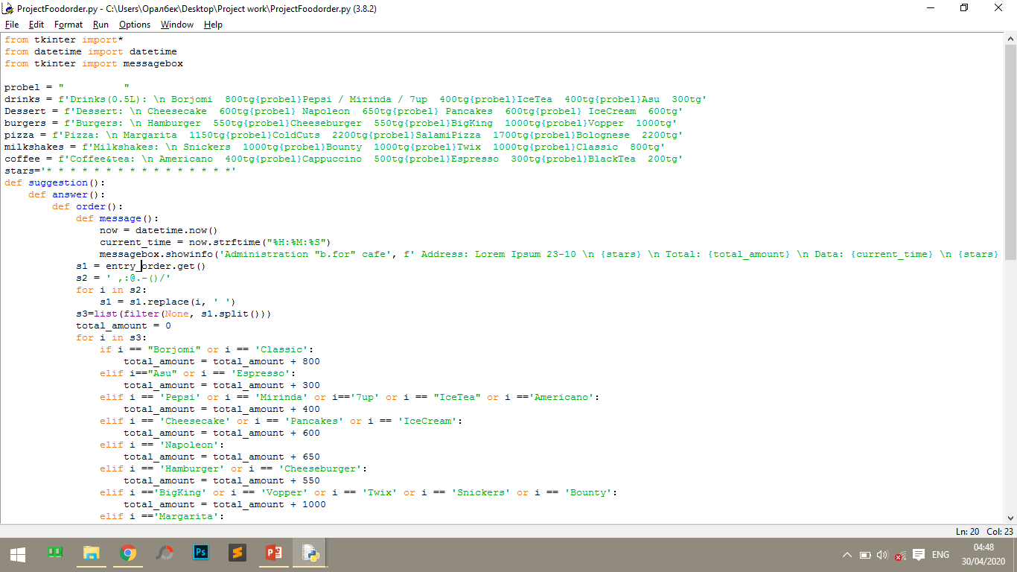
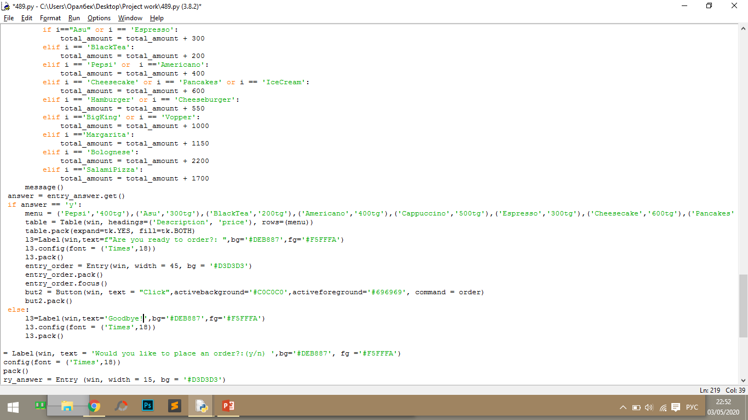
after that we call the function
function to be executed when the button is pressed:
Variable value
next function: order

Slide 9
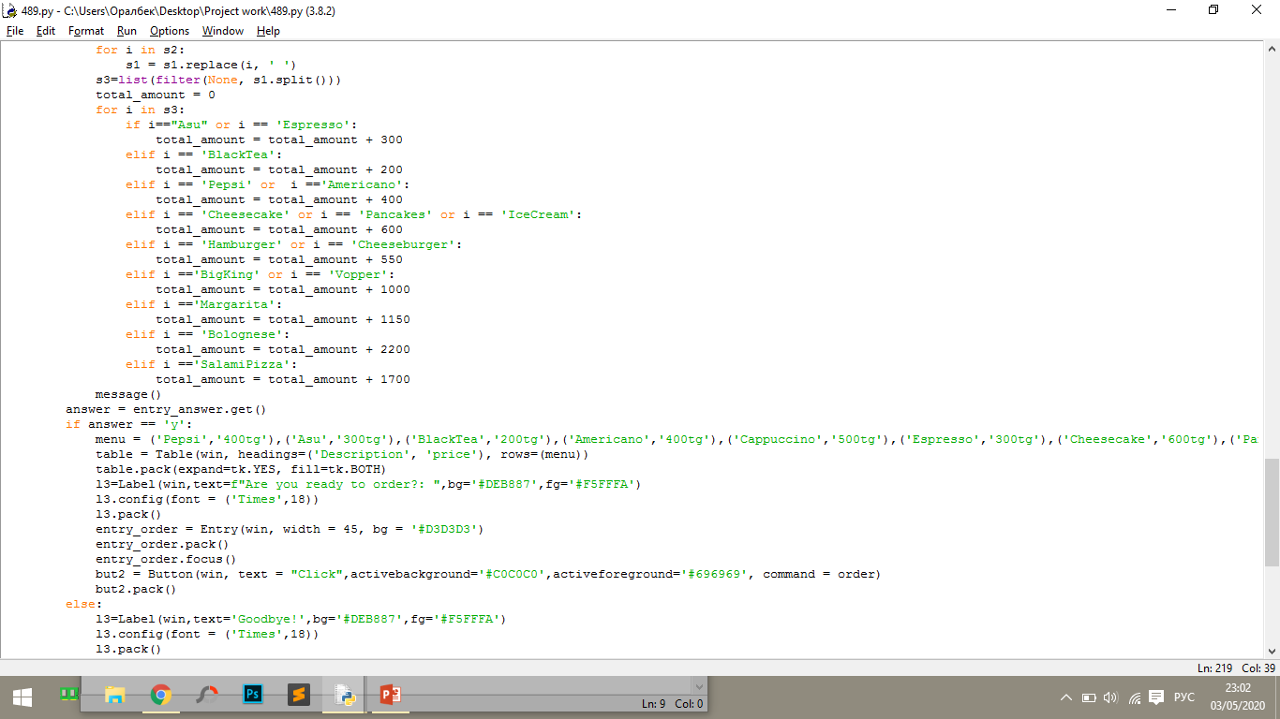
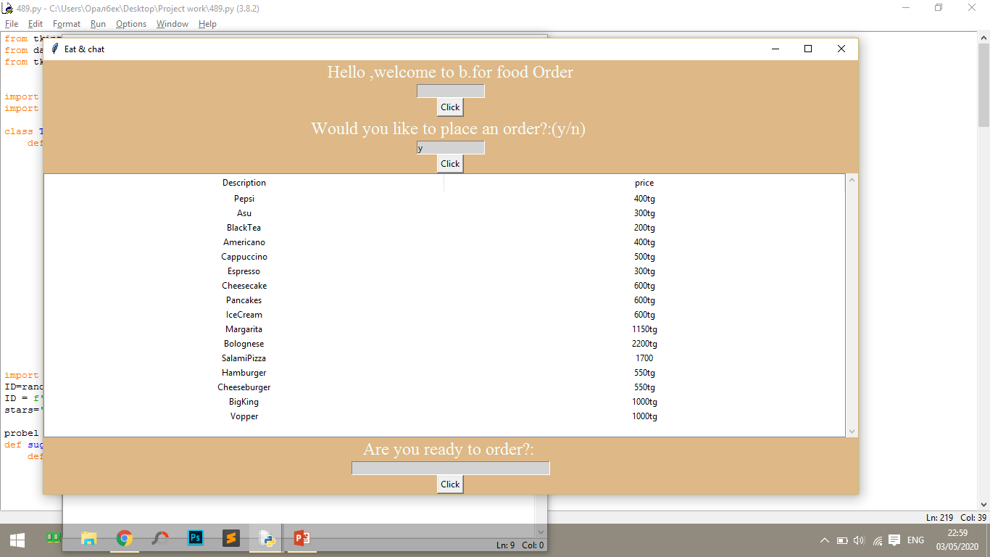
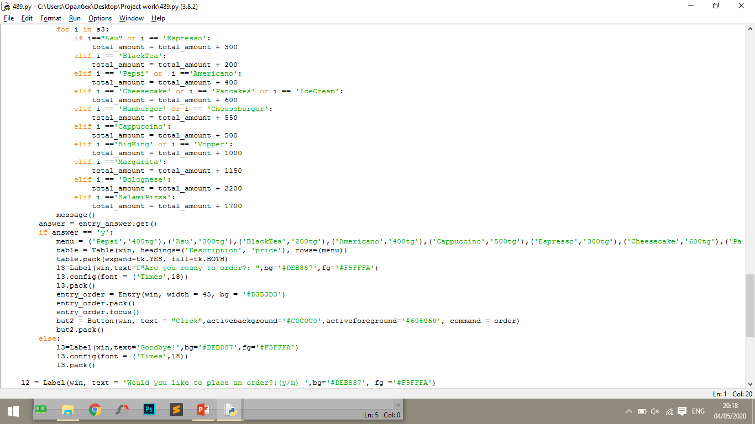
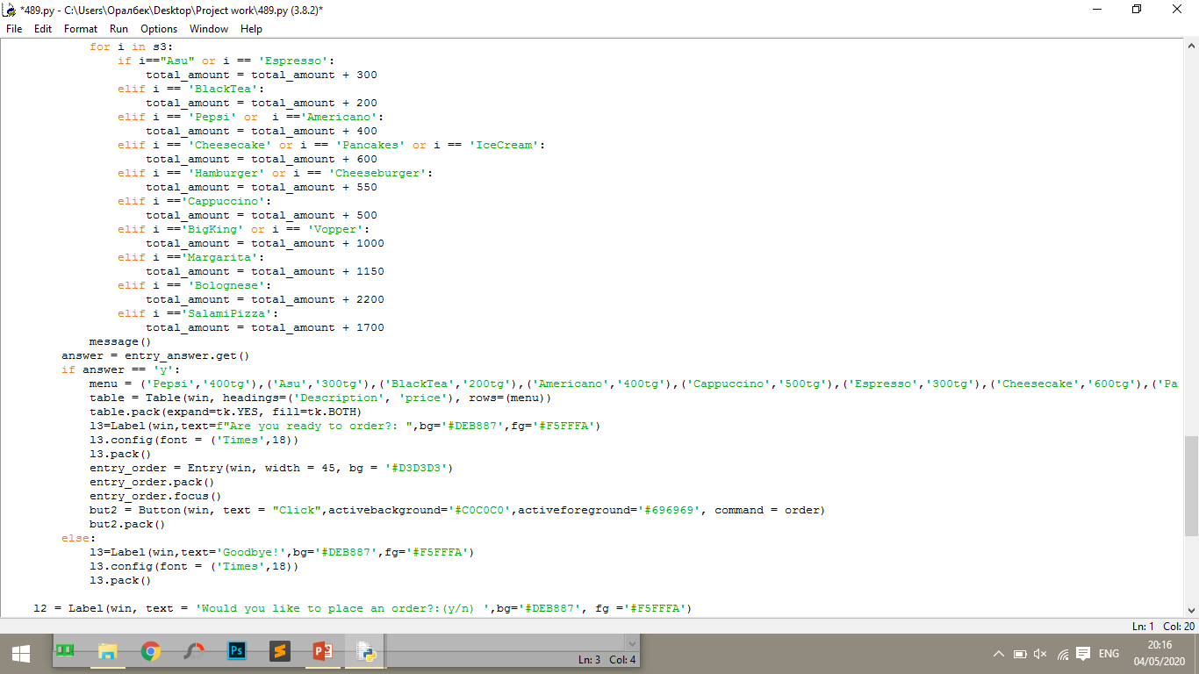
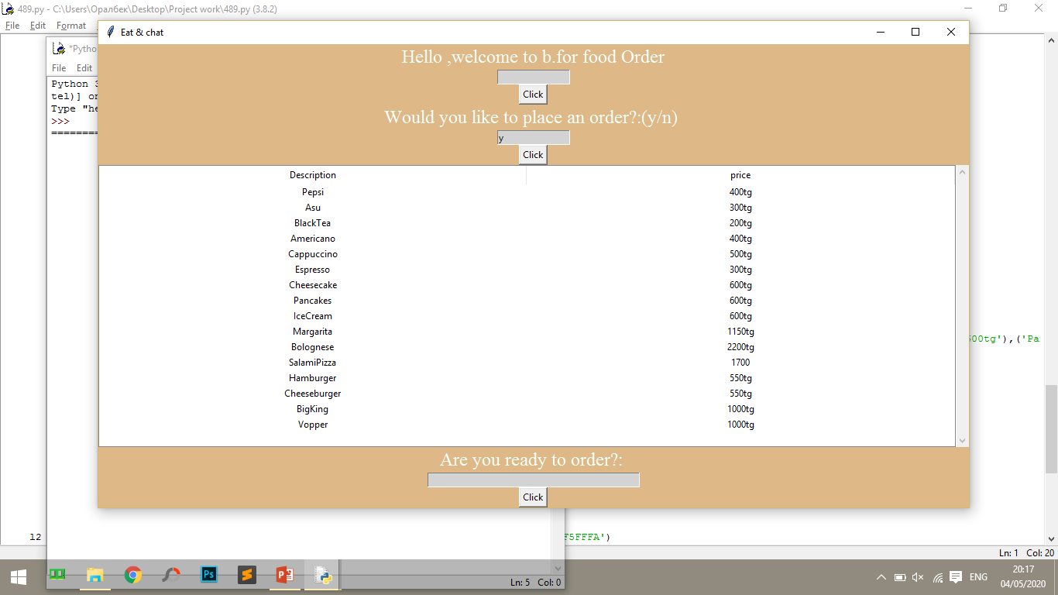
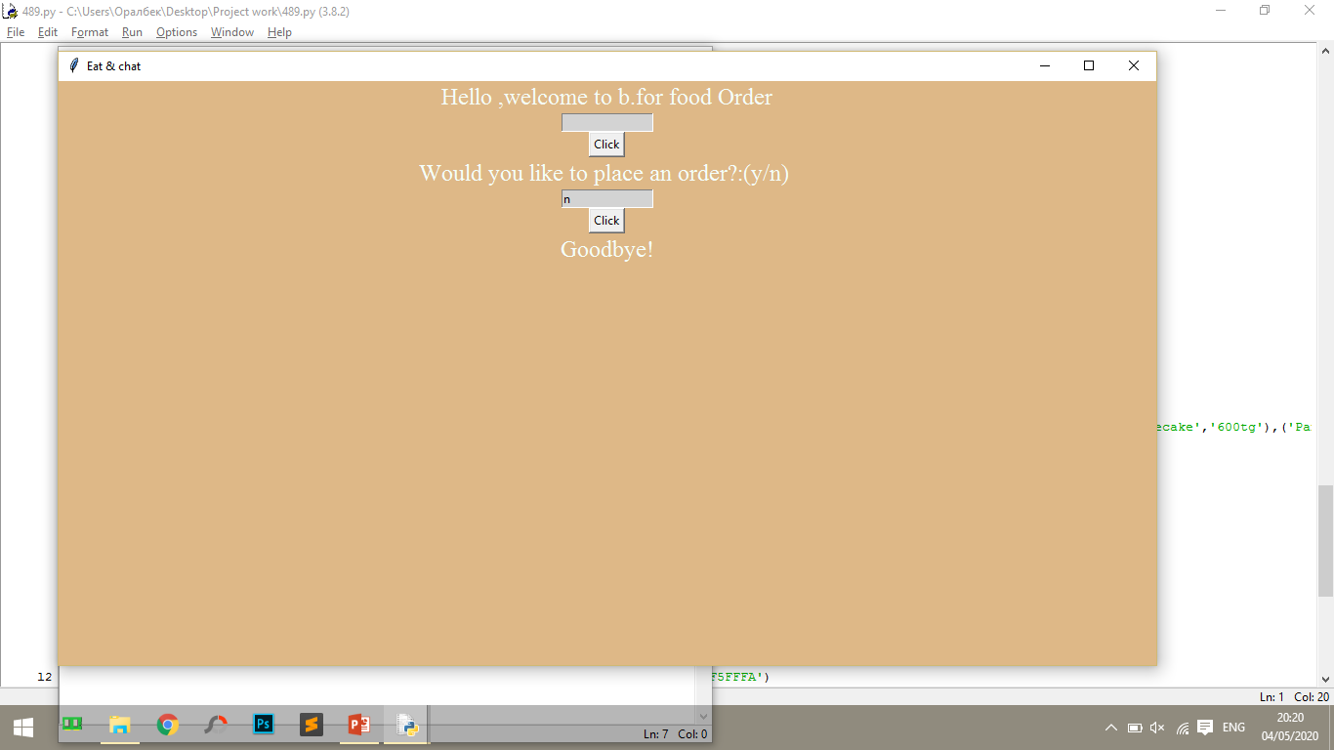
The result will be as follows:

Slide 10

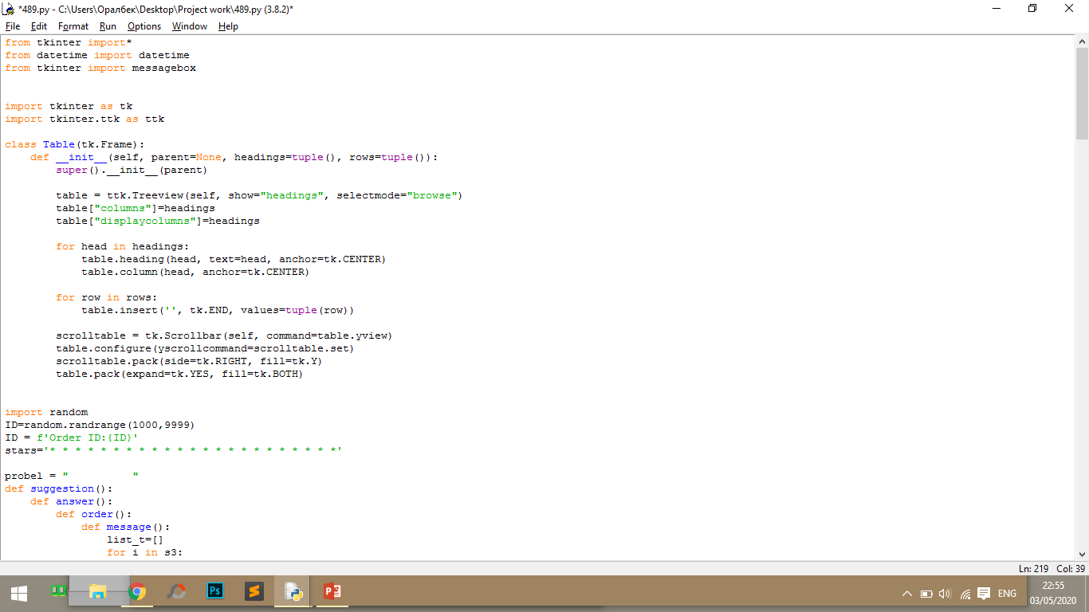
Table creation
https://python-scripts.com/question/10891
I took a piece of this code in one of the programming forums, because I'm new to the python world.
There is one piece of code that gets tuples from the sqlite table and creates the table. To work, you need to import everything from tkinter and tkinter.ttk.
This is a constant, the literal string "end". In this context, it represents a point immediately after the last character entered by the user
This widget is used to display items with a hierarchy.
In this anchor, you indicate which point of the widget you are referring to,
This widget provides a slide controller that is used to implement vertical scrollable widgets such as Listbox, Text, and Canvas.

Slide 11
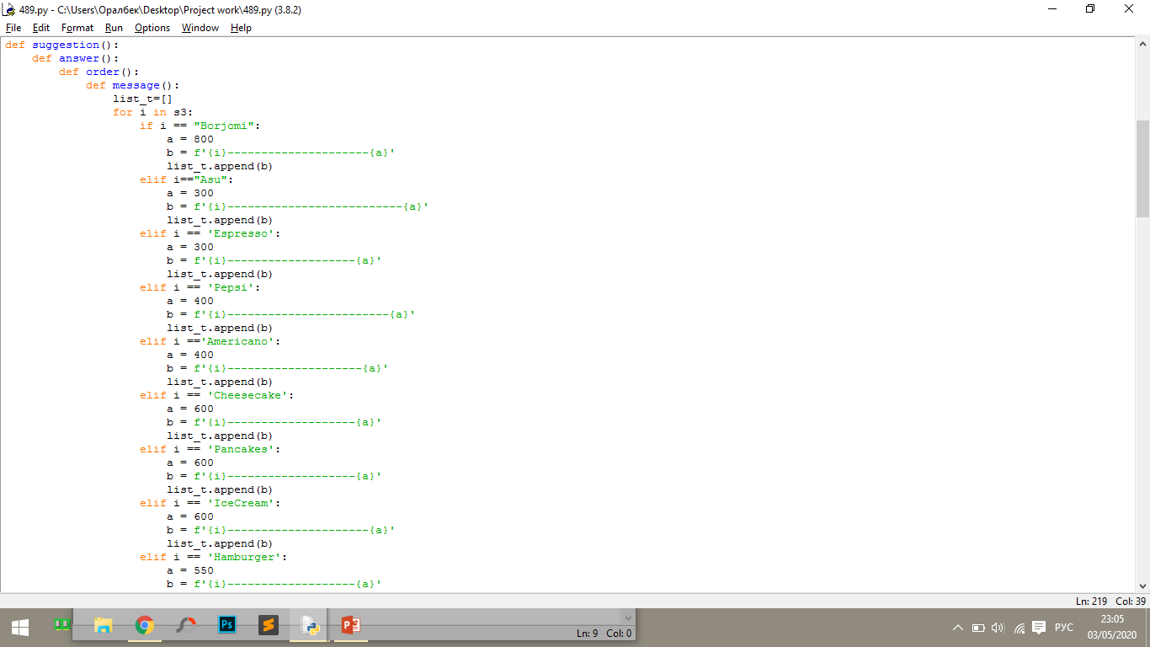
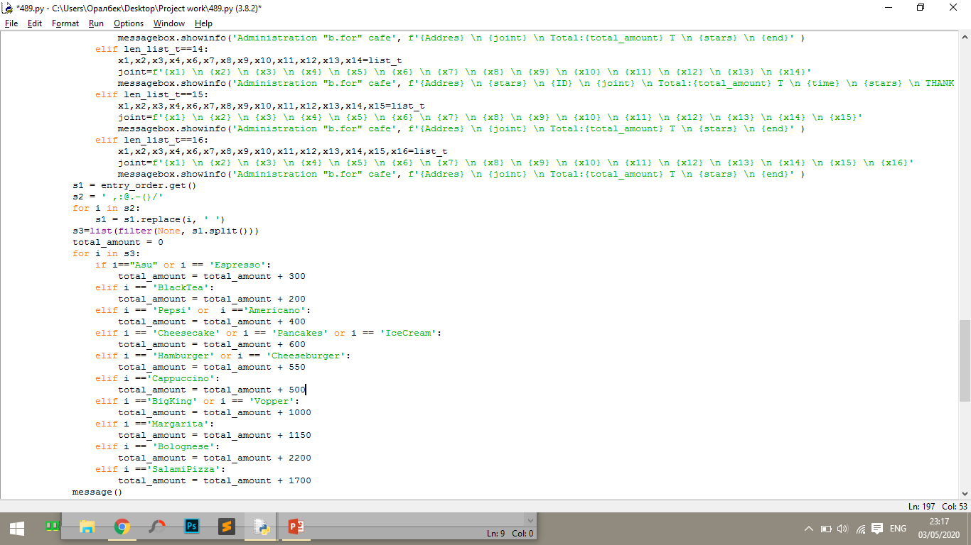
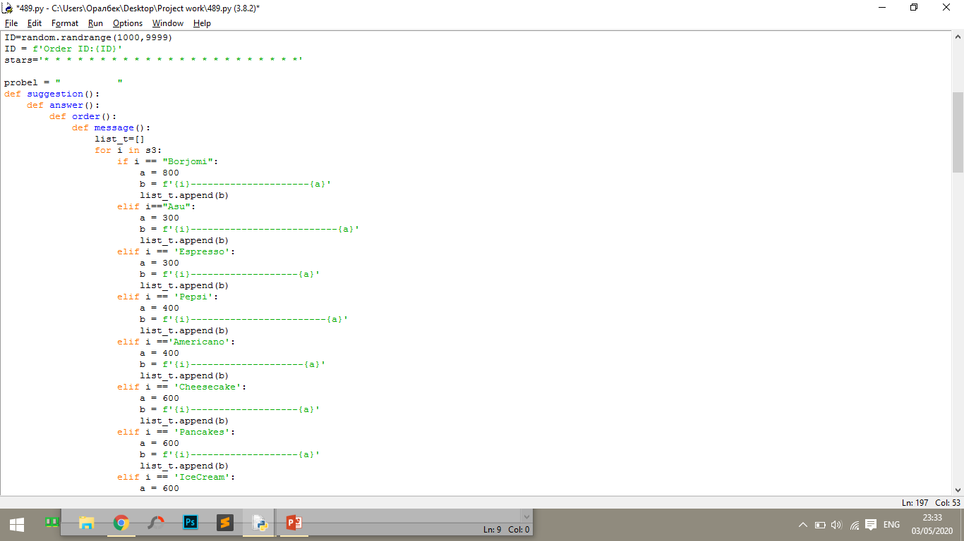
Function order
we collect the received data in the list “s3”
using the loop to find the total amount
enable function:message
create an empty list
the received data is added to the list with the price

Slide 12
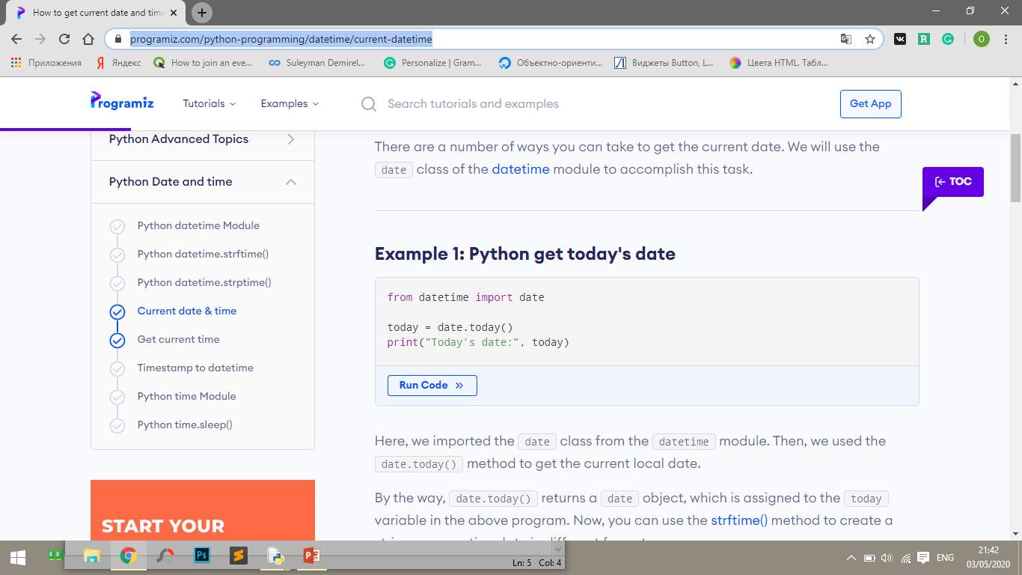
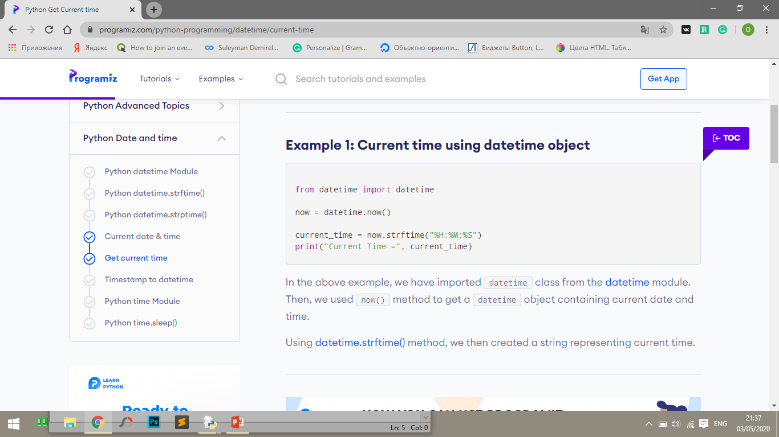
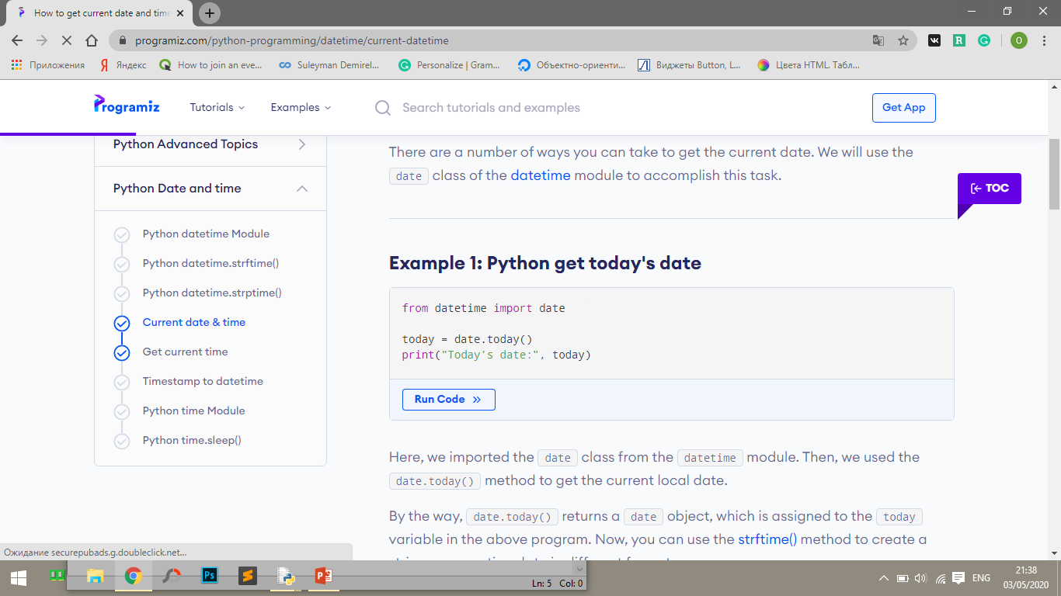
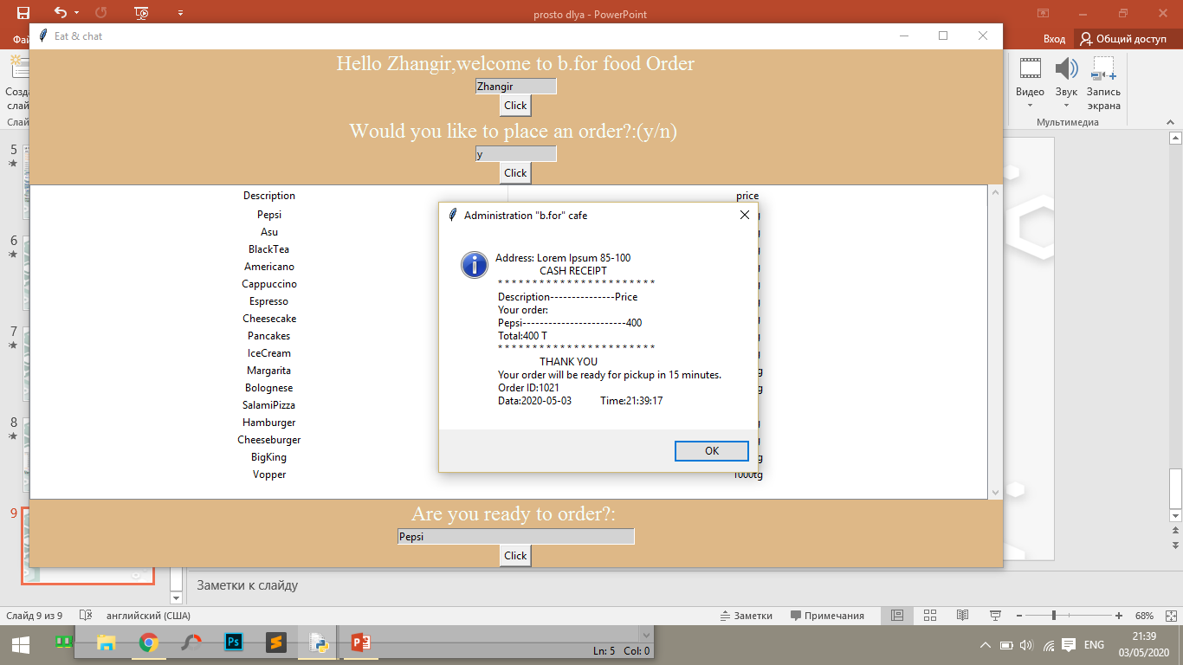
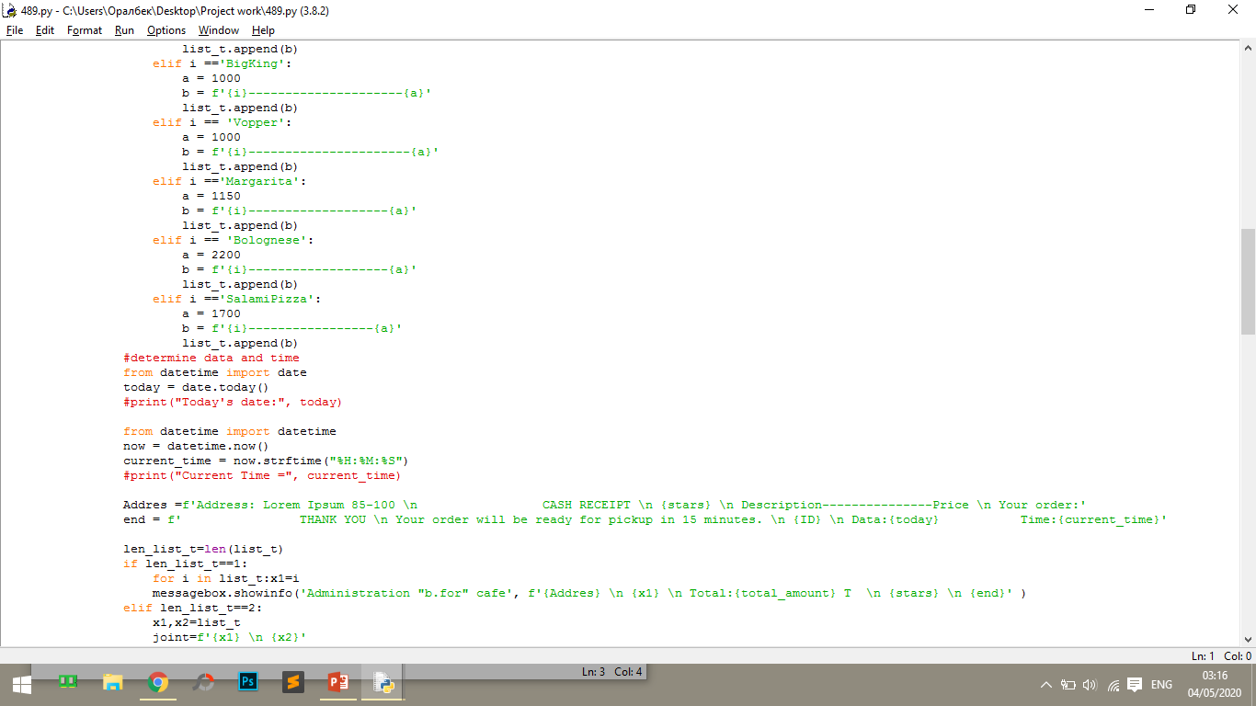
https://www.programiz.com/python-programming/datetime/current-datetime
to display the current time and date I took information in this site

Slide 13
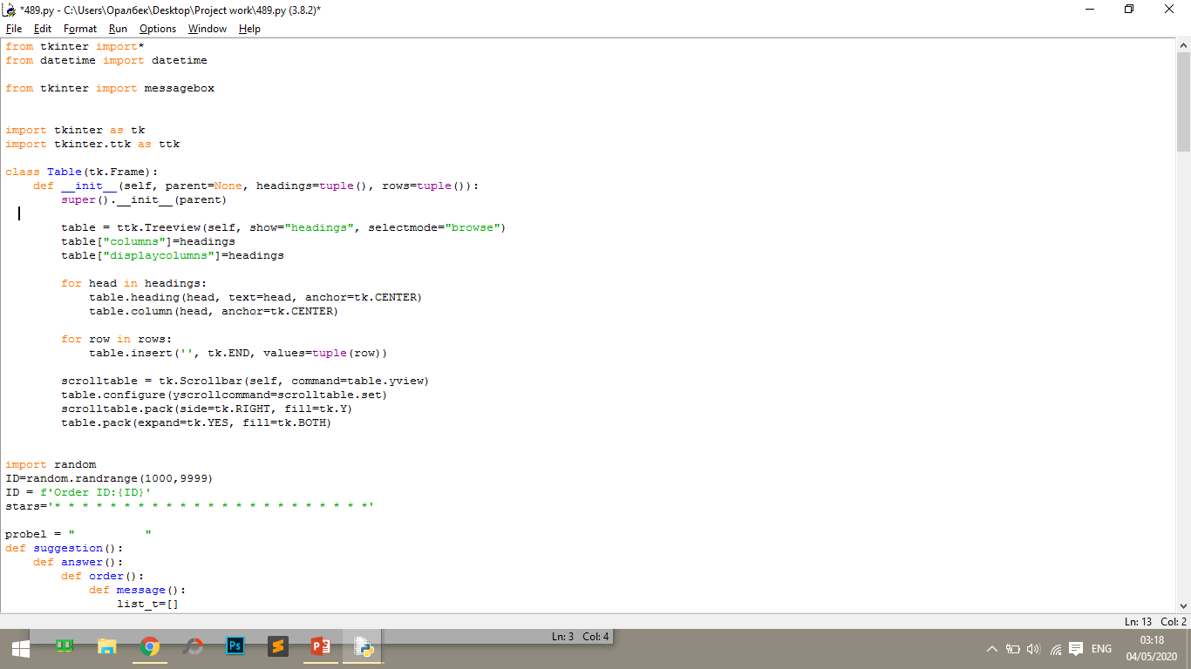
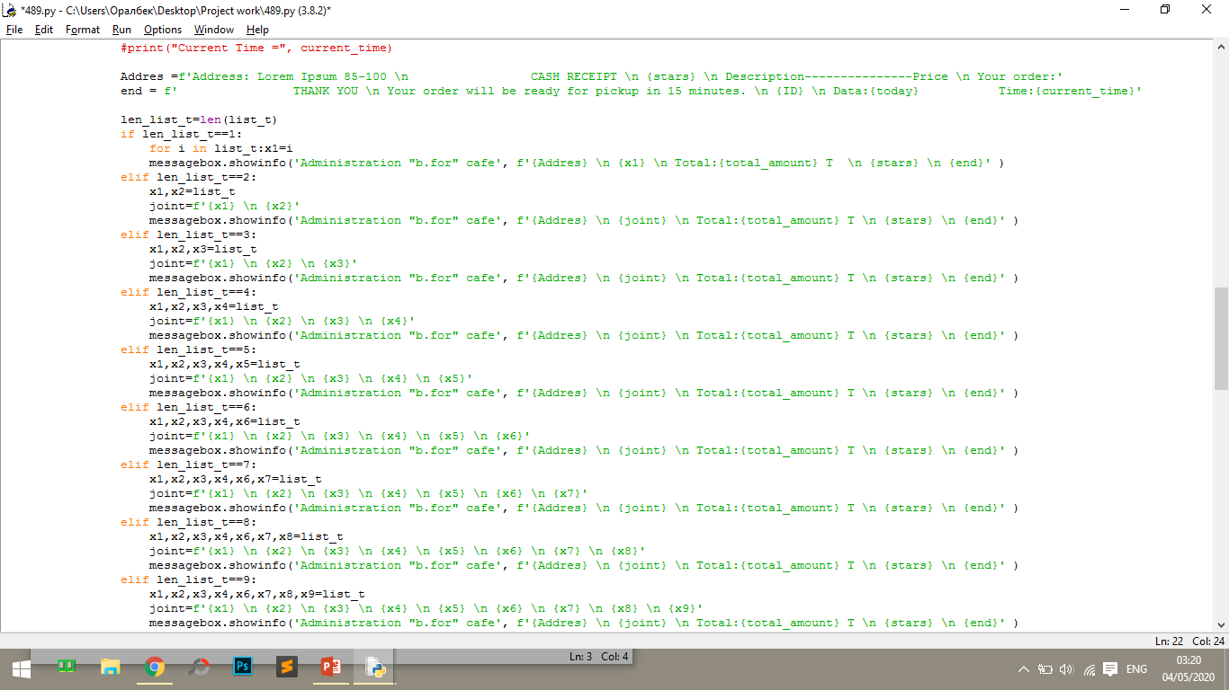
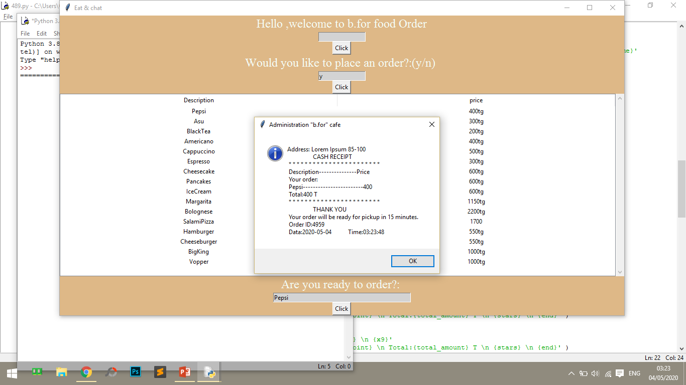
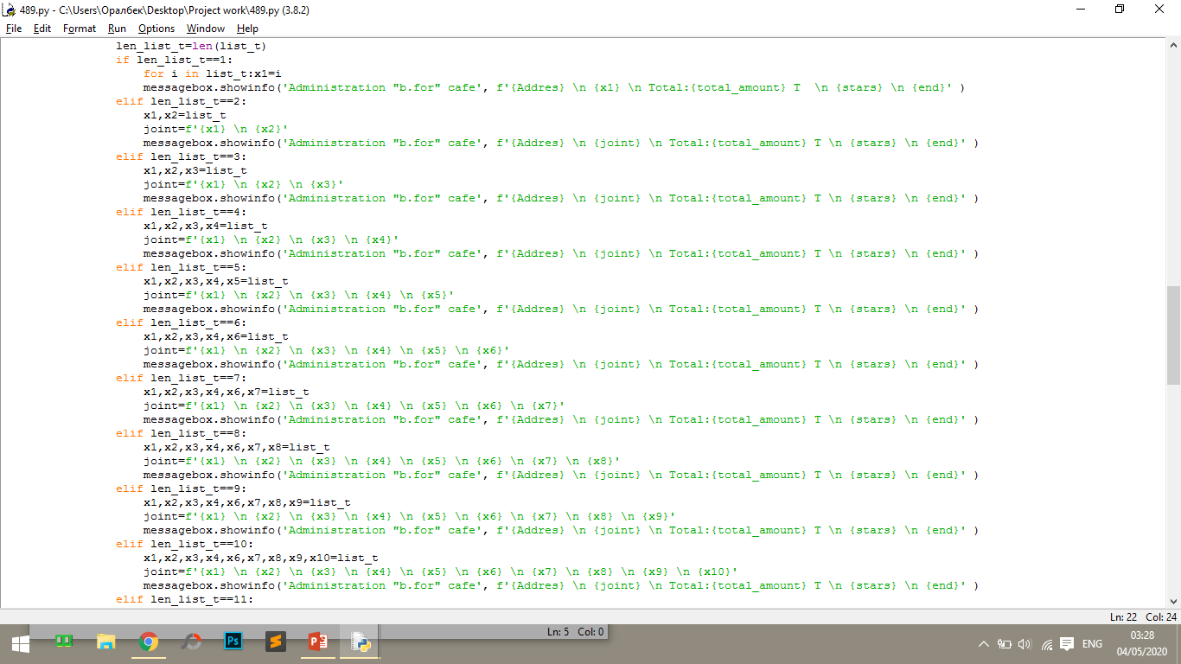
Message
this is how we create a message box that will look like this
using the length functions we find the number of elements
write each element in this list, in order from the bottom we can’t get a complete list, to do this we need to find out the number of elements from the list and divide them into other variables

Slide 14
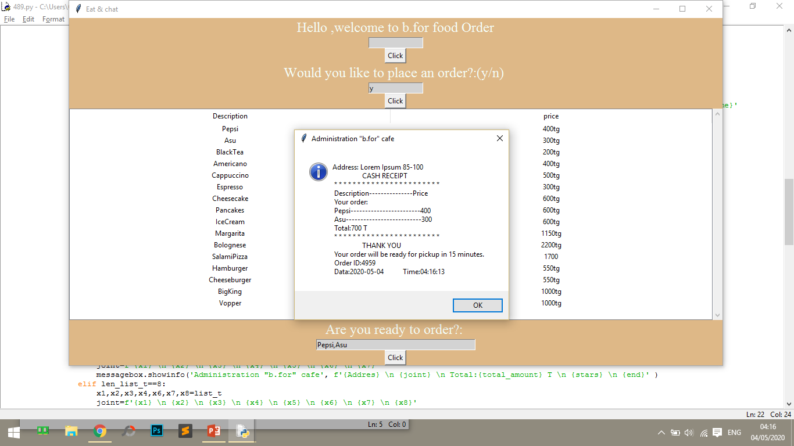
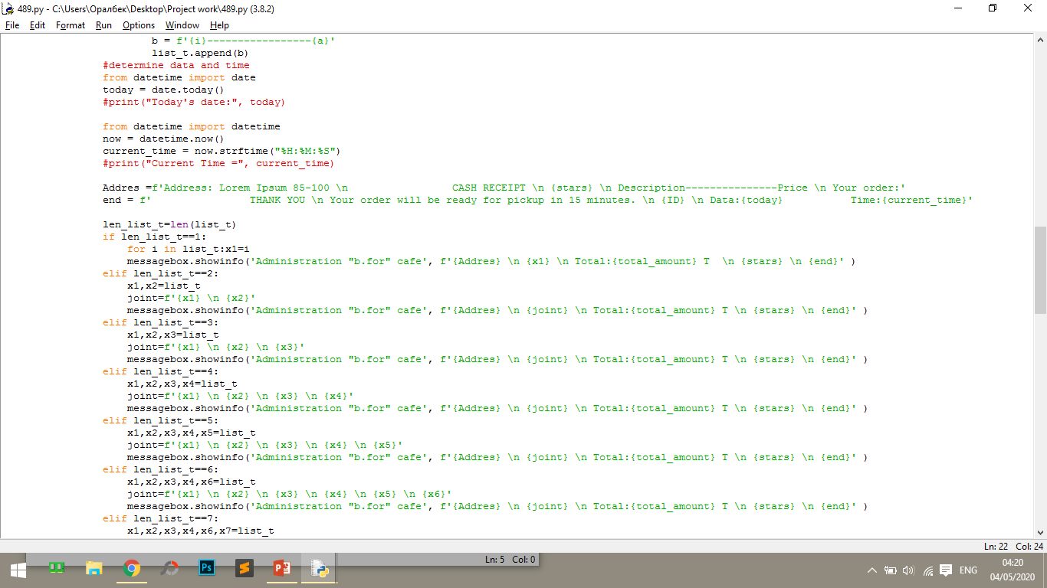
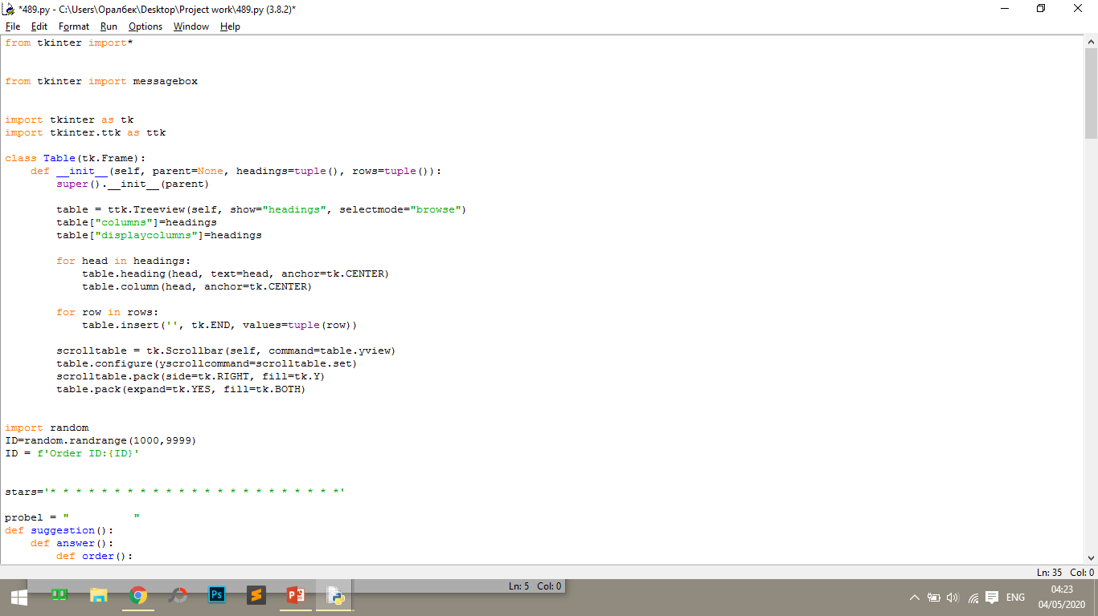
As a result, we get such a message
Variable value

Slide 15
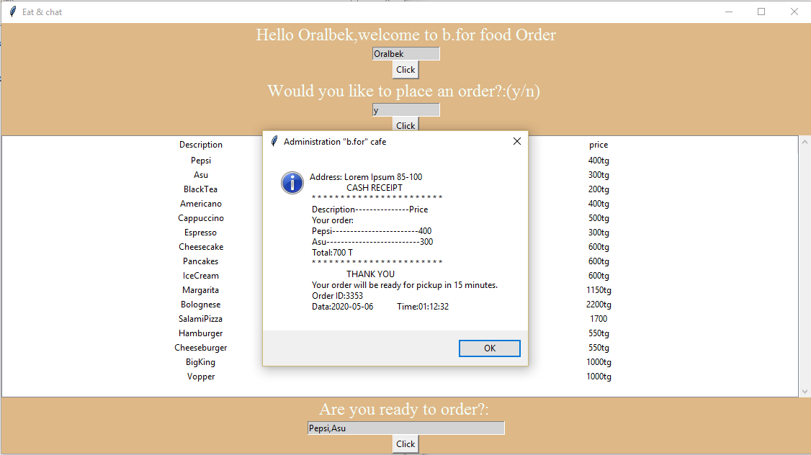
The result will look like this

Slide 16

Thank you for your the attention

